Slide 1
Microservice architecture
Len Bass
Notes:
This is the slide title. The title of the lecture topic goes in:
<Lecture Title Here>
The lecturer should put their name in:
<Presenter’s Name Here>

Slide 2
Overview
What is a microservice architecture?
How does it cut down on coordination?
copyright 2015 Len Bass

Slide 3
Definition
A microservice architecture is
  A collection of independently deployable processes
  Packaged as services
  Communicating only via messages
copyright 2015 Len Bass

Slide 4
~2002 Amazon instituted the following design rules - 1
All teams will henceforth expose their data and functionality through service interfaces.
Teams must communicate with each other through these interfaces.
There will be no other form of inter-process communication allowed: no direct linking, no direct reads of another team’s data store, no shared-memory model, no back-doors whatsoever. The only communication allowed is via service interface calls over the network.

Slide 5
Amazon design rules - 2
It doesn’t matter what technology they[services] use.
All service interfaces, without exception, must be designed from the ground up to be externalizable.
Amazon is providing the specifications for the “Microservice Architecture”.

Slide 6
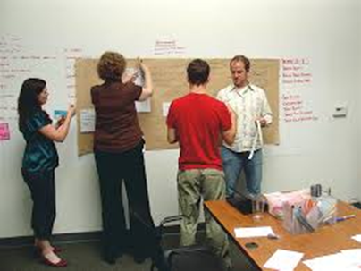
In Addition
Amazon has a “two pizza” rule.
No team should be larger than can be fed with two pizzas (~7 members).
Each (micro) service is the responsibility
of one team
This means that microservices are
small and intra team bandwidth
is high
Large systems are made up of many microservices.
There may be as many as 140 in a typical Amazon page.

Slide 7
Services can have multiple instances
The elasticity of the cloud will adjust the number of instances of each service to reflect the workload.
Requests are routed through a load balancer for each service
This leads to
  Lots of load balancers
  Overhead for each request.
copyright 2015 Len Bass

Slide 8
Digression into Service Oriented Architecture (SOA)
  The definition of microservice architecture sounds a lot like SOA.
  What is the difference?
  Amazon did not use the term “microservice architecture” when they introduced their rules. They said “this is SOA done right”
© Len Bass 2015

Slide 9
SOA typically has but microservice architecture does not
Enterprise service bus
Elaborate protocols for sending messages to services (WDSL*)
Each service may be under the control of different organization
Brokers
etc
© Len Bass 2015

Slide 10

Micro service architecture
Each user request is satisfied by some sequence of services.
Most services are not externally available.
Each service communicates with other services through service interfaces.
Service depth may
  Shallow (large fan out)
  Deep (small fan out, more dependent services)
Service

Slide 11
How does microservice architecture reduce requirements for coordination?
Coordination decisions can be made
  incrementally as system evolves or
  be built into the architecture.
Microservice architecture builds most coordination decisions into architecture
Consequently they only need to be made once for a system, not once per release.
copyright 2015 Len Bass

Slide 12
Seven Decision Categories
Architectures can be categorized by means of seven categories
  Allocation of functionality
  Coordination model
  Data model
  Management of resources
  Mapping among architectural elements
  Binding time decisions
  Technology choices
copyright 2015 Len Bass

Slide 13
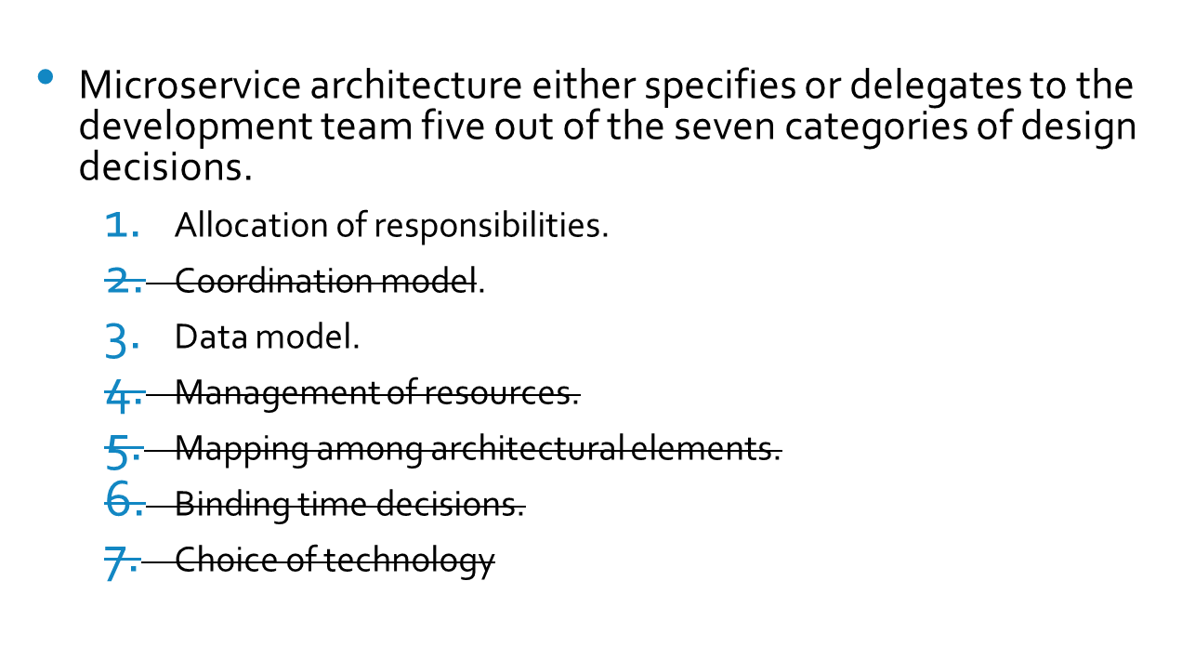
Design decisions made or delegated by choice of microservice architecture

Slide 14
Roadmap for next several slides
Micro service oriented architectural style will either specify or allow delegation of five different categories of design decisions.
Each decision category will be discussed separately.

Slide 15
Decision 1 – allocation of responsibilities
This decision is not delegated to the team or specified.
Development teams must coordinate to divide responsibilities for features that are to be added.
Typically this happens at the beginning of each iteration cycle.

Slide 16
Decision 2 - coordination model
Elements of service interaction
  Services communicate asynchronously through message passing
  Each service could (in principle) be deployed anywhere on the net.
    Latency requirements will probably force particular deployment location choices.
    Services must discover location of dependent services.
  State must be managed

Slide 17
State management
Services can be stateless or stateful
  Stateless services
    Allow arbitrary creation of new instances for performance and availability
    Allow messages to be routed to any instance
    State must be provided to stateless services
  Stateful services
    Require clients to communicate with same instance
    Reduces overhead necessary to acquire state

Slide 18
Where to keep the state?
Persistent state is kept in a database
  Modern database management systems (relational) provide replication functionality
  Some NoSQL systems may be replicated. Others will require manual replication.
Transient small amounts of state can be kept consistent across instances by using tools such as Memcached or Zookeeper. This is a mechanism for making a stateful service stateless.
Instances may cache state for performance reasons. It may be necessary to purge the cache before bringing down an instance.

Slide 19
Decision 3 – Data model
Schema based database system (relational). Requires coordination.
  Development teams must coordinate when schema is defined or modified.
  Schema definition happens once when the architecture is defined. Schema modification should be rare occurrence. Schema extensions (new fields or tables) do not cause problems.
NoSQL systems. Will still require coordination over semantics of data.
  Data written by one service is typically read by others, they must agree on semantics.

Slide 20
Decision 4 – Resource Management
Each instance of a service can process a certain workload.
  Could be expressed in terms of requests
  Could be expressed in terms of resource requirements – e.g. CPU
Each client instance will require resources from the service to process its requests.
Service Level Agreements (SLAs) are a means for automating the resource assumptions of the clients and the resource requirements of the service.

Slide 21
Decision 5 – Mapping among architectural elements
Decisions about packaging modules into processes and processes into a service are delegated to the service development team.
Decisions about deployment of a service will be discussed later.

Slide 22
Decision 6 – Binding time
Configuration information binding time is decided during the development of architecture and the deployment pipeline.
Other binding time decisions are delegated to the service development team.

Slide 23
Decisions 7 – Technology choices
All technology choices are delegated to the service development team.

Slide 24
Summary
Microservice architecture packages services as small independent processes
Each team makes its own technology choices for their services. This simplifies deployment
© Len Bass 2015

